Slide 1

UPM and climate
CARNEGIE ESG SEMINAR
Sami Lundgren
VP, UPM Responsibility

Slide 2
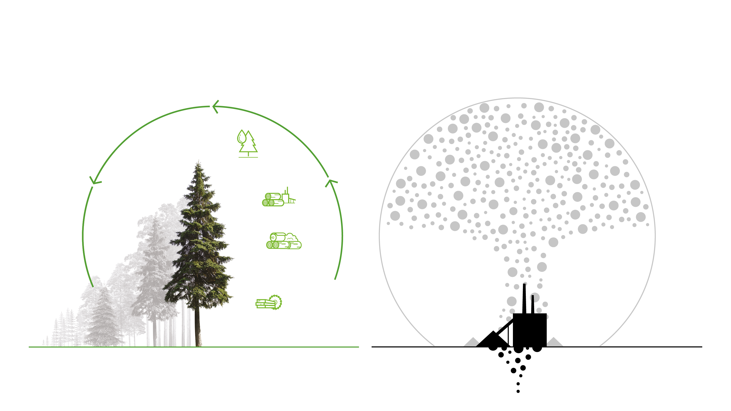
Bioeconomy offers a sustainable alternative to fossil-based economy
Biomass use is not increasing CO₂ to carbon cycle
Use of fossil resources increases CO₂ amount
Use of fossils has increased
global CO₂ -emissions
Biofuels and biochemicals
Wood for energy
Wood fiber for pulp and paper production
Timber and plywood
Energy from fossil resources
Source: IPCC AR5
2
Notes:
Biotalous tarjoaa kestävän vaihtoehdon fossiilitaloudelle
Puut sitovat kasvaessaan ilmasta hiiltä ja kun puu maatuu tai palaa vapautuu sama hiilimäärä takaisin ilmakehään
Puiden hyödyntäminen ei siis tuo maailman hiilen kiertoon lisää hiilidioksidia toisin kuin 100 miljoonaa vuotta vanhojen
fossiilivarantojen hyödyntäminen maaperästä
Ilmaston lämpeneminen johtuu fossiilisten polttoaineiden ja raaka-aineiden käytöstä ja se myös ratkaistaan ensisijaisesti vähentämällä niiden käyttöä
Myös metsätaloudella ja maankäytöllä on vaikutusta ilmakehään – mikä näkyy kuvasta. Siksi onkin tärkeää että metsäkato maailmassa saadaan pysäytettyä, maailmaan saadaan lisää metsiä joiden avulla korvataan fossiilikulutusta

Slide 3
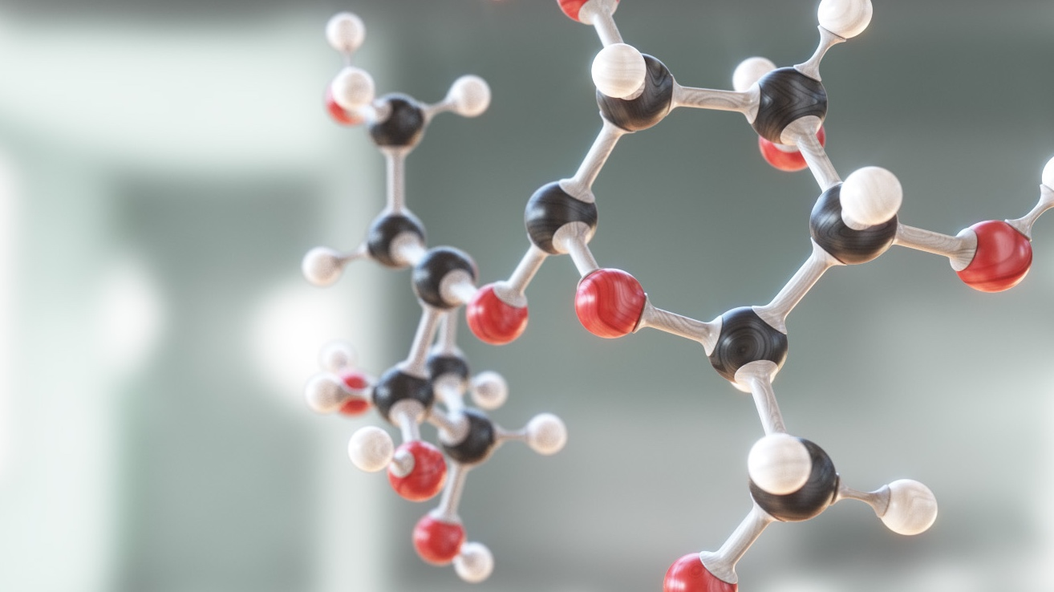
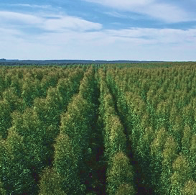
Comprehensive approach to climate
change mitigation
Forests
Carbon sinks and storages maintenance, forestation, renewal
| © UPM
| © UPM
| © UPM
Notes:
Osana Beyond fossils-strategiaamme olemme lanseeranneet kokonaisvaltaisen lähestymistavan ilmastonmuutoksen torjuntaan
Vaikutus on paljon kokonaisvaltaisempi kuin pelkästään tuotannon päästöihin tuijottaminen
metsiä on ylläpidettävä hoitamalla niitä
Istutamme 100 puuta minuutissa ja ylläpidämme yli 100 miljoonan tonnin hiilivarastoa globaalisti
Enemmän metsiä – enemmän hiilivarastoja
Hoidetut metsät ovat ainoa pysyvä hiilivarasto
Kun metsiä hoidetaan ja korjatusta puusta tehdään kestäviä tuotteita luodaan markkinaehtoinen kannustin metsin hoidolle ja kasvun lisäämiselle – talousmetsät ja talousmetsätalous
Lisäksi maailmaa voi aina metsittää lisää
UPM Energy on lähes fossiilivapaa.
Tehtailla meillä on yli 70% uusiutuvia polttoaineita
Energiatehokkuuden parantamiseen 1 %:n vuotuinen parantamistavoite - vastaa noin 20 000 suomalaisen omakotitalon vuosittaista energiankulutusta
Mutta tärkeintä on, että biopohjaisilla tuotteilla voidaan korvata fossiilipohjaisia.

Slide 4
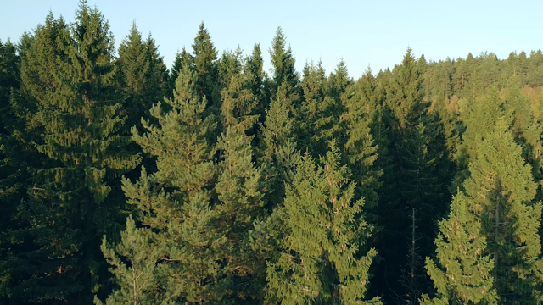
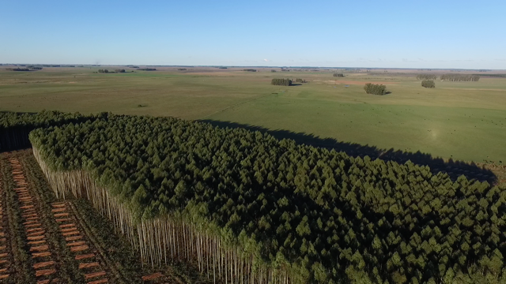
Sustainably managed forests grow more, while taking care of biodiversity and carbon sinks
100
We plant over
trees per minute
Annual growth in Finland from
50 million to 107 million m³ since 1960’s
From 0 to 1 million ha in 30 years
in Uruguay

Slide 5
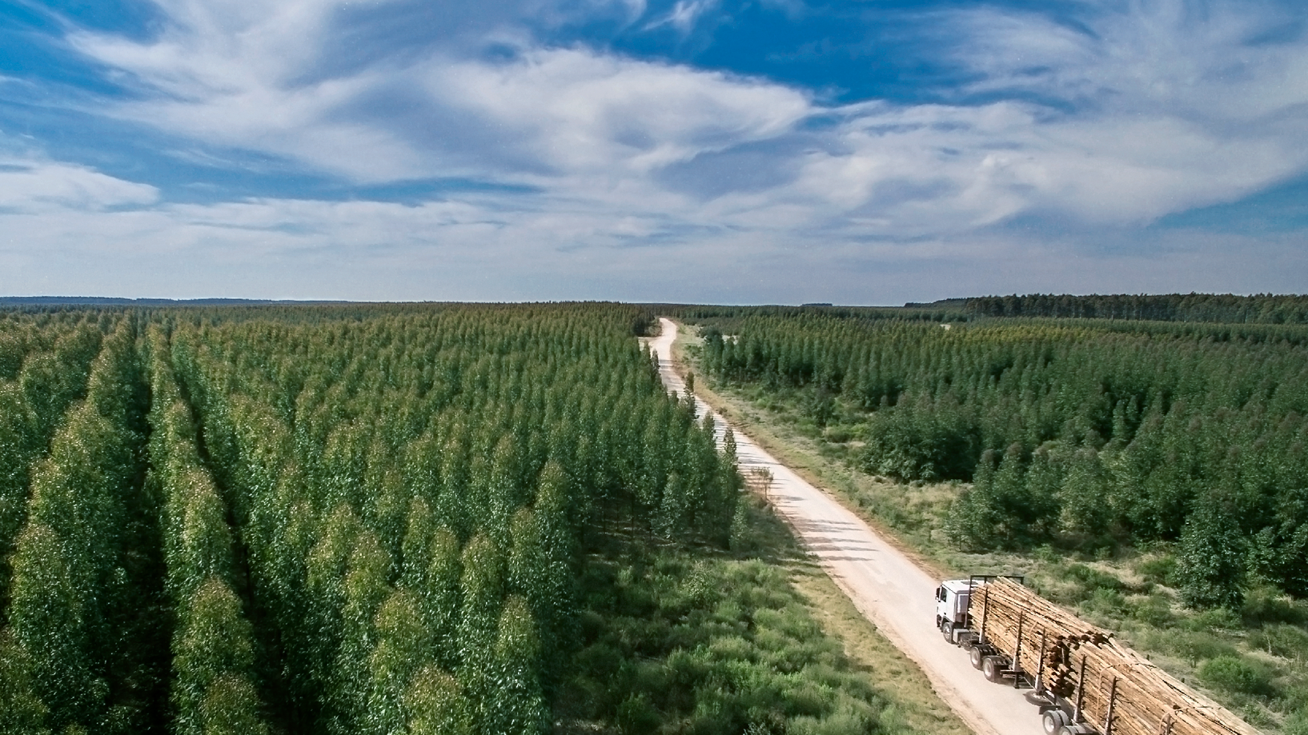
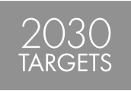



Sustainable forestry preserves forests and increases carbon sinks
In Uruguay a new
carbon sink of
IN FINLAND a carbon storage of
390M
25M
tonnes in own forests
tonnes in 25 years
Forests are the
SECOND LARGEST
ABSORBER OF CO₂
after the oceans
| © UPM
Notes:
We are both a major forest owner and a purchaser of wood. We own a total of nearly 850 000 hectares of forestry land in Finland, Uruguay and Minnesota, USA. Most of this land is located in Finland, totaling roughly 512,000 hectares, followed by Uruguay (258,000) and the United States (75,000 hectares). We additionally manage around 1,1 million hectares of private forest.
We plant 50 million trees every year – one hundred trees every minute. In addition, we sell out roughly 20 million seedlings to various partners and operators who plant them.
Our plantations in Uruguay constitute a carbon sink of approximately 24 million tonnes that did not exist 30 years ago.
FINNISH FOREST RESOURCES are growing at a record pace. The reason for this is good forestry. Growing forests bind carbon from the atmosphere that is stored in wood, creating a carbon sink. The annual growth rate of trees in Finnish forests has increased from 50 million m3 in the 1960s to 107 million m3 per year. Only about 72 million m3 (3% of the carbon storage) of the growth is used for industrial and other uses, so trees and the stored carbon dioxide increase every year. This increased growth of Finnish forests has created an annual carbon sink of 27 million tonnes.
SUSTAINABLE PLANTATIONS were established in Uruguay in the 1990s to replace the impoverished pastures. Plantations now cover one million hectares of land; of this land, UPM owns 258,000 hectares. Approximately 60% of the area consists of eucalyptus plantations. The rest is made up of natural pastures, conservation areas, roads and other infrastructures.

Slide 6
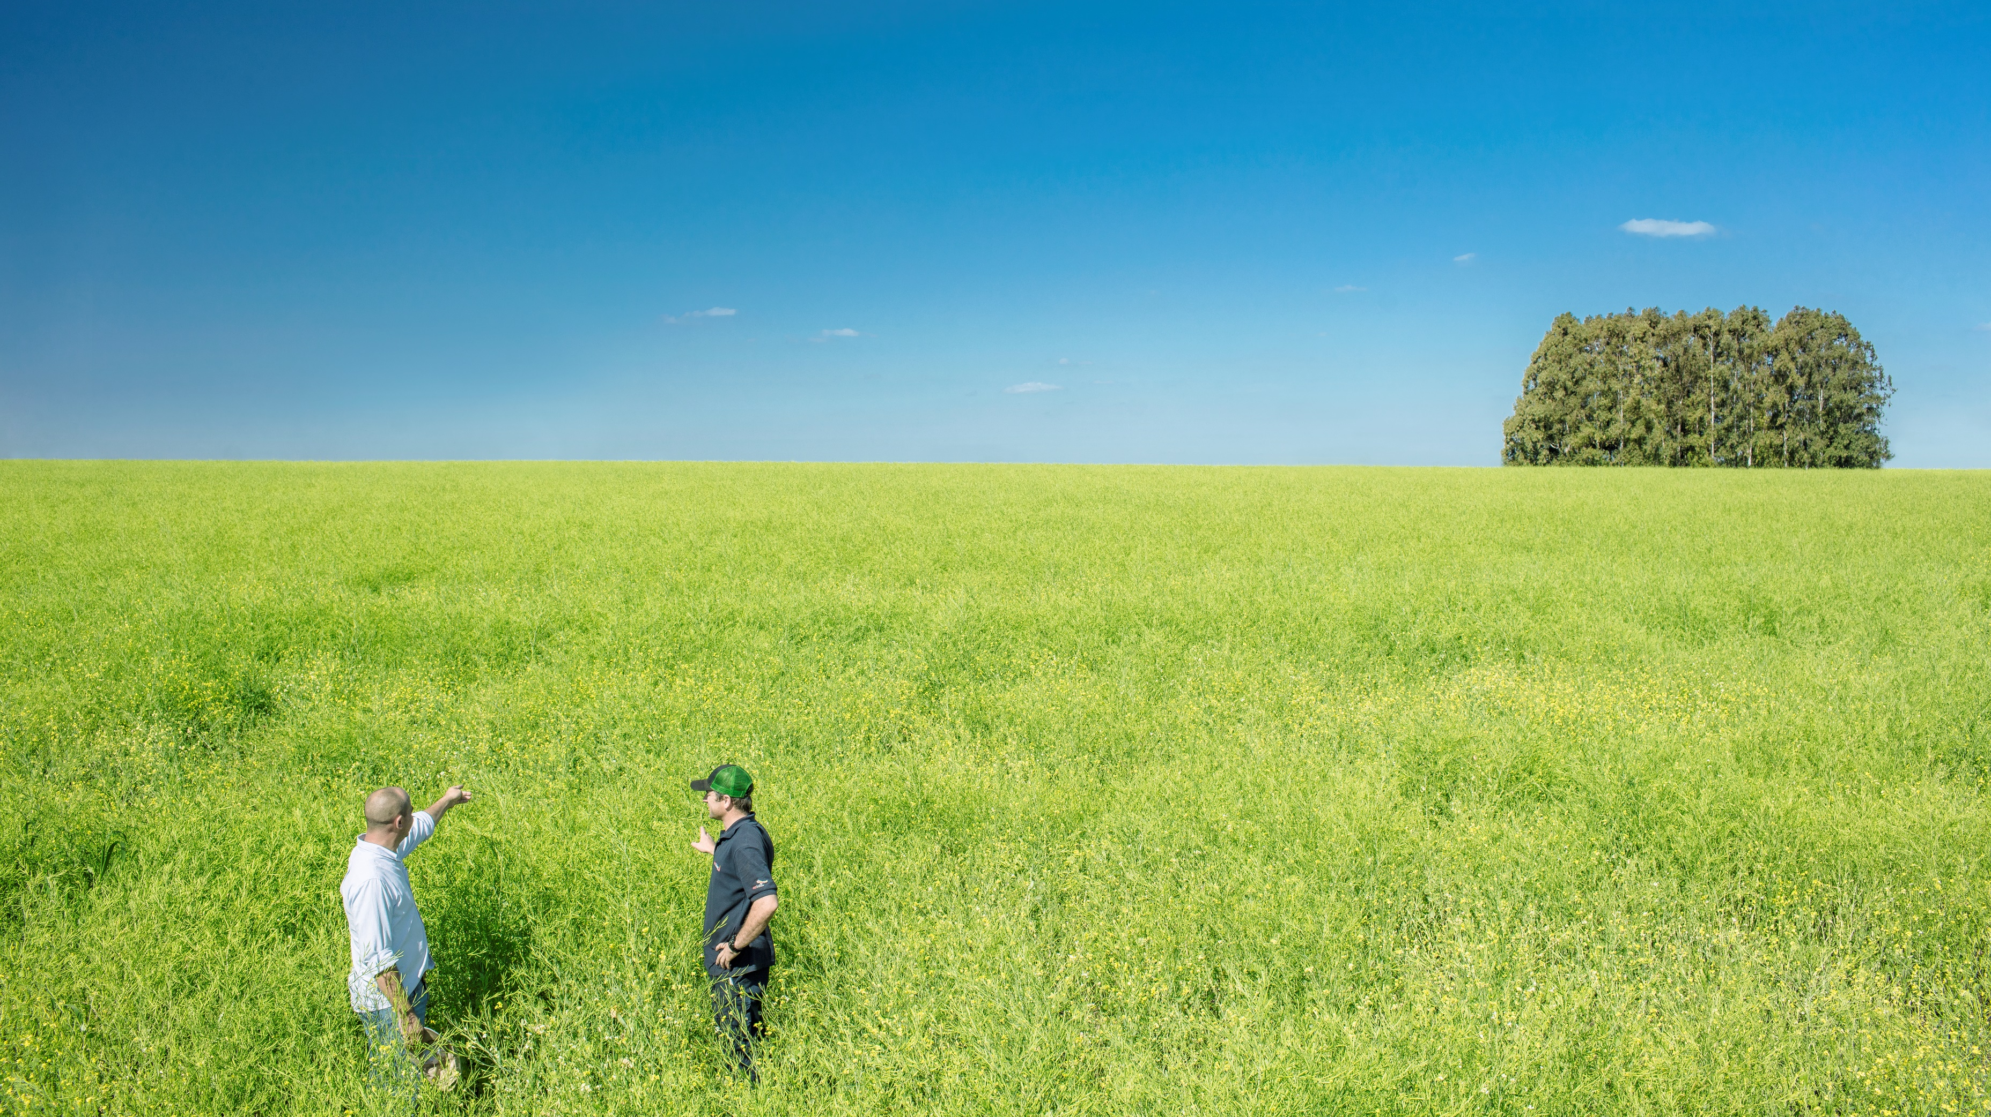

Carbon farming for climate positive fuels: Brassica Carinata in Uruguay by UPM
6
| © UPM

Slide 7
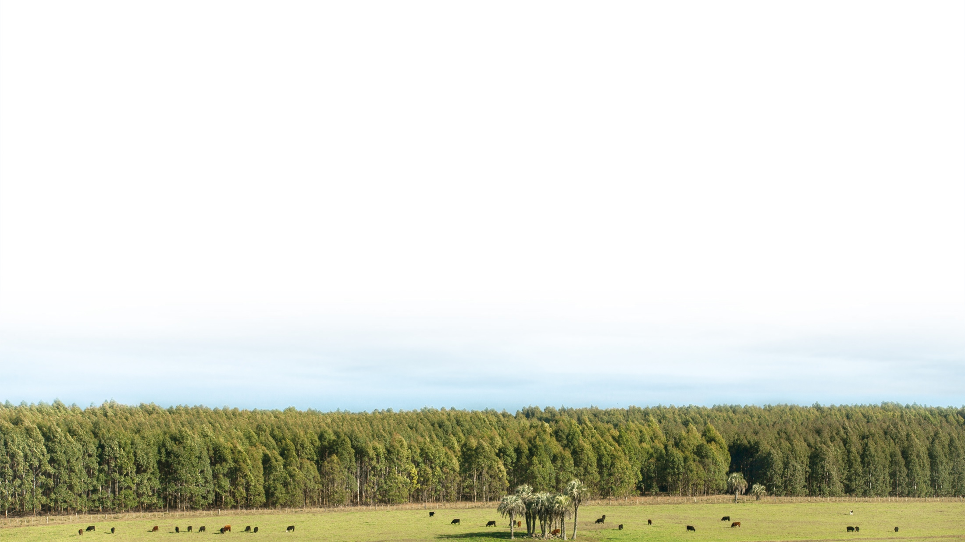
This is sustainable land use at UPM
Our own forests and plantations are 100% certified
All fibre we use is certified by 2030 (2018: 81%)
We know the origin of wood
Strong stakeholder engagement
Own long-term and global biodiversity programme
No competing with food production
No wood from tropical rainforests
or plantations established
by destroying rainforest
No operations in areas where the rights of indigenous peoples are threatened
| © UPM
Notes:
All of our own forests are certified. In Finland, they are certified by the PEFC™ and most of them also by the FSC®, and in the USA (Minnesota) by the PEFC. Our eucalyptus plantations in Uruguay are certified by both the FSC and the PEFC. Of all fibre we use, 81% is certified.
Our company forests are strategically important in a number of ways. They are an important source of wood for our mills, but their role extends far beyond this. Our forests and nurseries – one in Finland, two in Uruguay – play a key role in advancing modern, sustainable forest management practices.
Our key stakeholders in forestry-related issues are forest owners, employees, investors, suppliers, local communities, non-governmental organizations, research organizations, governments, regulators and the media. We have a local presence both as a major forest owner and as a purchaser of wood. Stakeholder dialogue is integrated into our daily forest management practices. We carefully assess the impacts of harvesting, especially when planning wood harvests near settlements or other sensitive areas.
We also seek out active dialogue and partnerships with non-governmental organizations both globally and at national and local level. Local environmental organizations perform hands-on conservation work at grassroots level. Our long-term target is to create a new local working culture with groups who share the same environmental interests.
We have also had our own global biodiversity programme over 20 years. Our main research areas include biodiversity, silvicultural practices, regeneration, tree breeding, ecosystem services and forestry-related social issues. Furthermore, our company forests enable hands-on training of our employees and contractors, as well as serving as a laboratory for R&D projects.
We have very clear and unambiguous statements regarding the use of forest, which are:
No competing with food production
No wood from tropical rainforests or plantations established by destroying rainforest
No operations in areas where the rights of indigenous peoples are threatened

Slide 8
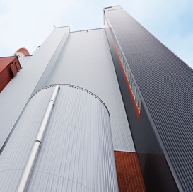
Comprehensive approach to climate
change mitigation
Forests
Production
Carbon sinks and storages maintenance, forestation, renewal
CO₂ emissions
low emission energy, energy efficiency
| © UPM
| © UPM
| © UPM
Notes:
Osana Beyond fossils-strategiaamme olemme lanseeranneet kokonaisvaltaisen lähestymistavan ilmastonmuutoksen torjuntaan
Vaikutus on paljon kokonaisvaltaisempi kuin pelkästään tuotannon päästöihin tuijottaminen
metsiä on ylläpidettävä hoitamalla niitä
Istutamme 100 puuta minuutissa ja ylläpidämme yli 100 miljoonan tonnin hiilivarastoa globaalisti
Enemmän metsiä – enemmän hiilivarastoja
Hoidetut metsät ovat ainoa pysyvä hiilivarasto
Kun metsiä hoidetaan ja korjatusta puusta tehdään kestäviä tuotteita luodaan markkinaehtoinen kannustin metsin hoidolle ja kasvun lisäämiselle – talousmetsät ja talousmetsätalous
Lisäksi maailmaa voi aina metsittää lisää
UPM Energy on lähes fossiilivapaa.
Tehtailla meillä on yli 70% uusiutuvia polttoaineita
Energiatehokkuuden parantamiseen 1 %:n vuotuinen parantamistavoite - vastaa noin 20 000 suomalaisen omakotitalon vuosittaista energiankulutusta
Mutta tärkeintä on, että biopohjaisilla tuotteilla voidaan korvata fossiilipohjaisia.

Slide 9
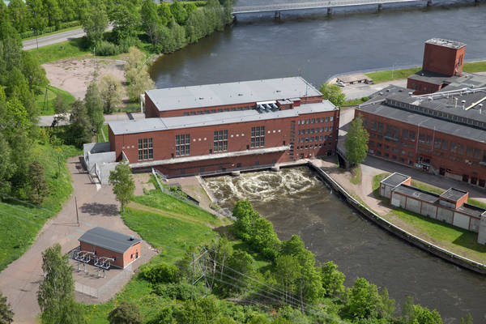
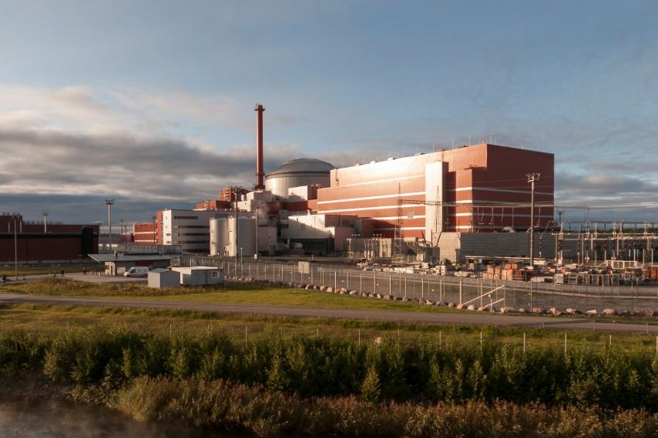
UPM Energy
97% CO₂ free

Slide 10




We continuously improve resource- efficiency in production
90%
70%
1%
of our production waste
is recycled or recovered
of the fuels used
are biomass-based
Annual energy efficiency target
| © UPM
Notes:
We constantly look for new solutions to minimise our environmental impact by selecting optimised raw materials, energy sources and production methods and developing new products and processes.
Our operations have direct and indirect impacts on the environment. Our production processes generate effluents and air emissions. Our plants also generate solid waste, noise and odour that needs to be managed. The indirect impacts of our business mainly arise from transportation and the procurement of raw materials, chemicals, fuels and power.
Our target is to reduce the environmental footprint of our operations and products throughout their lifecycle, all the way from raw material sourcing, production, delivery and product use to their recycling and reuse. Our mill sites place special emphasis on preventing air and water pollution, reducing waste and energy consumption, and mitigating local impacts such as noise and odour.
Our mills use integrated, certified management systems as practical tools for mitigating environmental impacts. These systems cover quality management, environmental protection, energy efficiency and health and safety issues. They embrace the principle of continuous improvement through target setting and monitoring.
Here a couple of good examples how we have improved our environmental performance over the years.

Slide 11
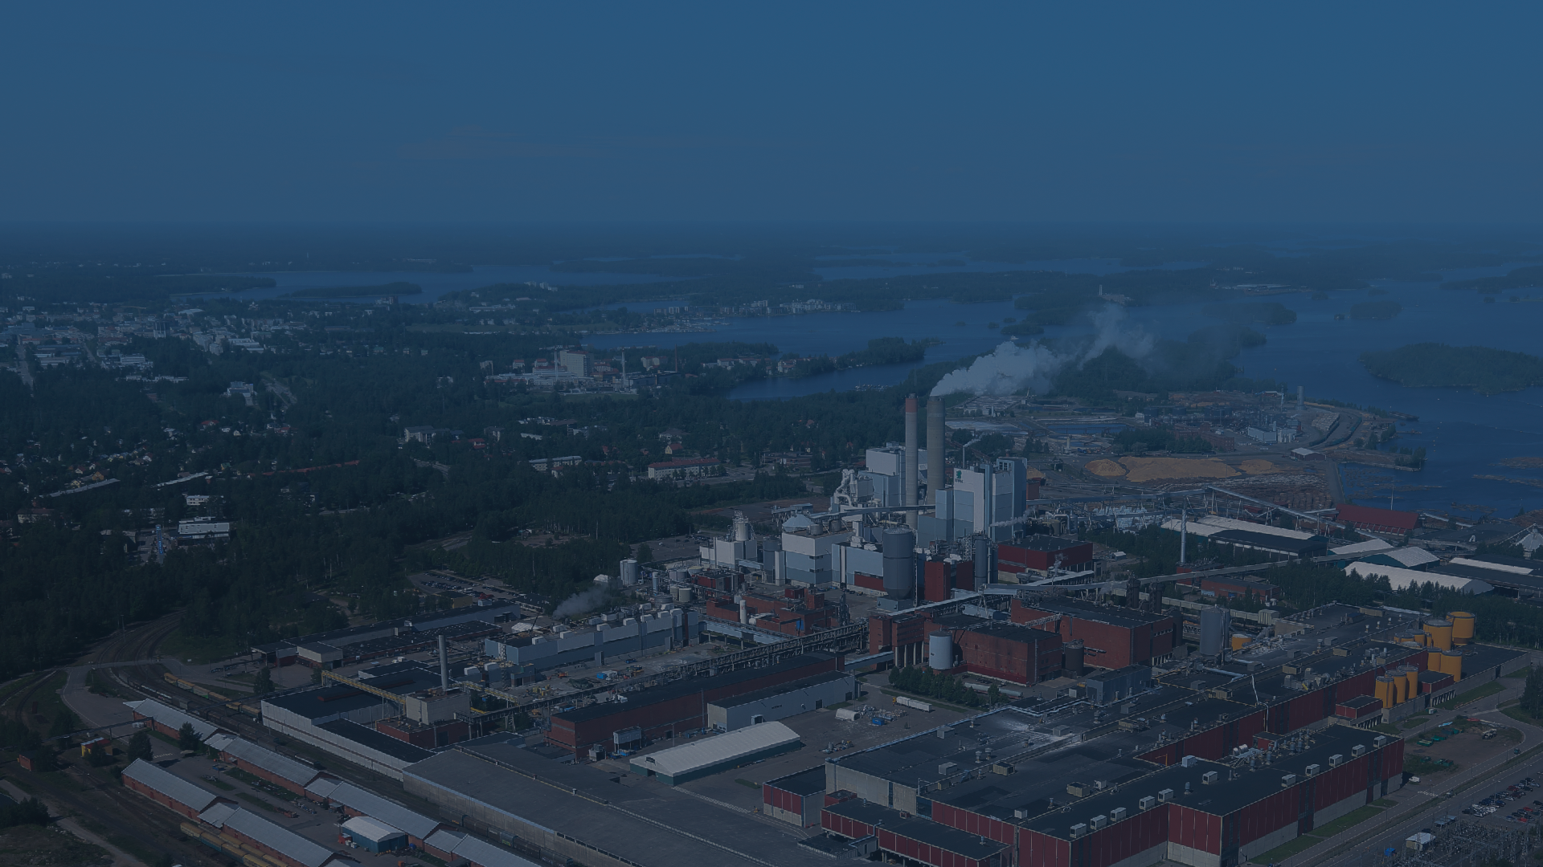
Target to reduce according to Science Based Targets (SBT)
- 4% in 2018
- 30% by 2030
1.1M
tonnes sold GoO’s
| © UPM
Notes:
Our activities and products have an impact on society as a whole. We constantly aim to better understand and communicate our added value. We disclose our direct and indirect value creation as part of our Annual Report.
In our extended pulp and paper mills’ EMAS statements, we strive to address our local societal impact as well as traditional environmental issues. As part of these reports, we provide verified concrete information on, for example, our contribution to employment, our tax revenue and purchasing power, and our co-operation with communities.
Our impacts are very wide, here some examples.

Slide 12
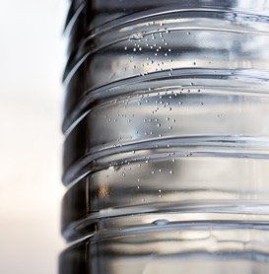
Comprehensive approach to climate
change mitigation
Forests
Production
Products
Carbon sinks and storages maintenance, forestation, renewal
CO₂ emissions
low emission energy, energy efficiency
Product substitution replacing fossils, recyclability, carbon storages
| © UPM
| © UPM
| © UPM
Notes:
Osana Beyond fossils-strategiaamme olemme lanseeranneet kokonaisvaltaisen lähestymistavan ilmastonmuutoksen torjuntaan
Vaikutus on paljon kokonaisvaltaisempi kuin pelkästään tuotannon päästöihin tuijottaminen
metsiä on ylläpidettävä hoitamalla niitä
Istutamme 100 puuta minuutissa ja ylläpidämme yli 100 miljoonan tonnin hiilivarastoa globaalisti
Enemmän metsiä – enemmän hiilivarastoja
Hoidetut metsät ovat ainoa pysyvä hiilivarasto
Kun metsiä hoidetaan ja korjatusta puusta tehdään kestäviä tuotteita luodaan markkinaehtoinen kannustin metsin hoidolle ja kasvun lisäämiselle – talousmetsät ja talousmetsätalous
Lisäksi maailmaa voi aina metsittää lisää
UPM Energy on lähes fossiilivapaa.
Tehtailla meillä on yli 70% uusiutuvia polttoaineita
Energiatehokkuuden parantamiseen 1 %:n vuotuinen parantamistavoite - vastaa noin 20 000 suomalaisen omakotitalon vuosittaista energiankulutusta
Mutta tärkeintä on, että biopohjaisilla tuotteilla voidaan korvata fossiilipohjaisia.

Slide 13

Sustainable and safe products for everyday use
PULP AND BIOFUEL
BASED MATERIALS
for packaging, transport, storage and hygiene products
TIMBER
for construction
ELECTRICITY
everywhere
PUBLICATION PAPERS
for reading and advertising
LABEL MATERIALS
for food packaging,
drink bottles and for communicating information
LABELS
for food products
SPECIALTY PAPERS
for food packaging
WOOD MATERIALS
for construction
and design features
OFFICE PAPERS
for printing
WOOD MATERIALS
for furniture and the home
| © UPM
| © UPM
| © UPM

Slide 14
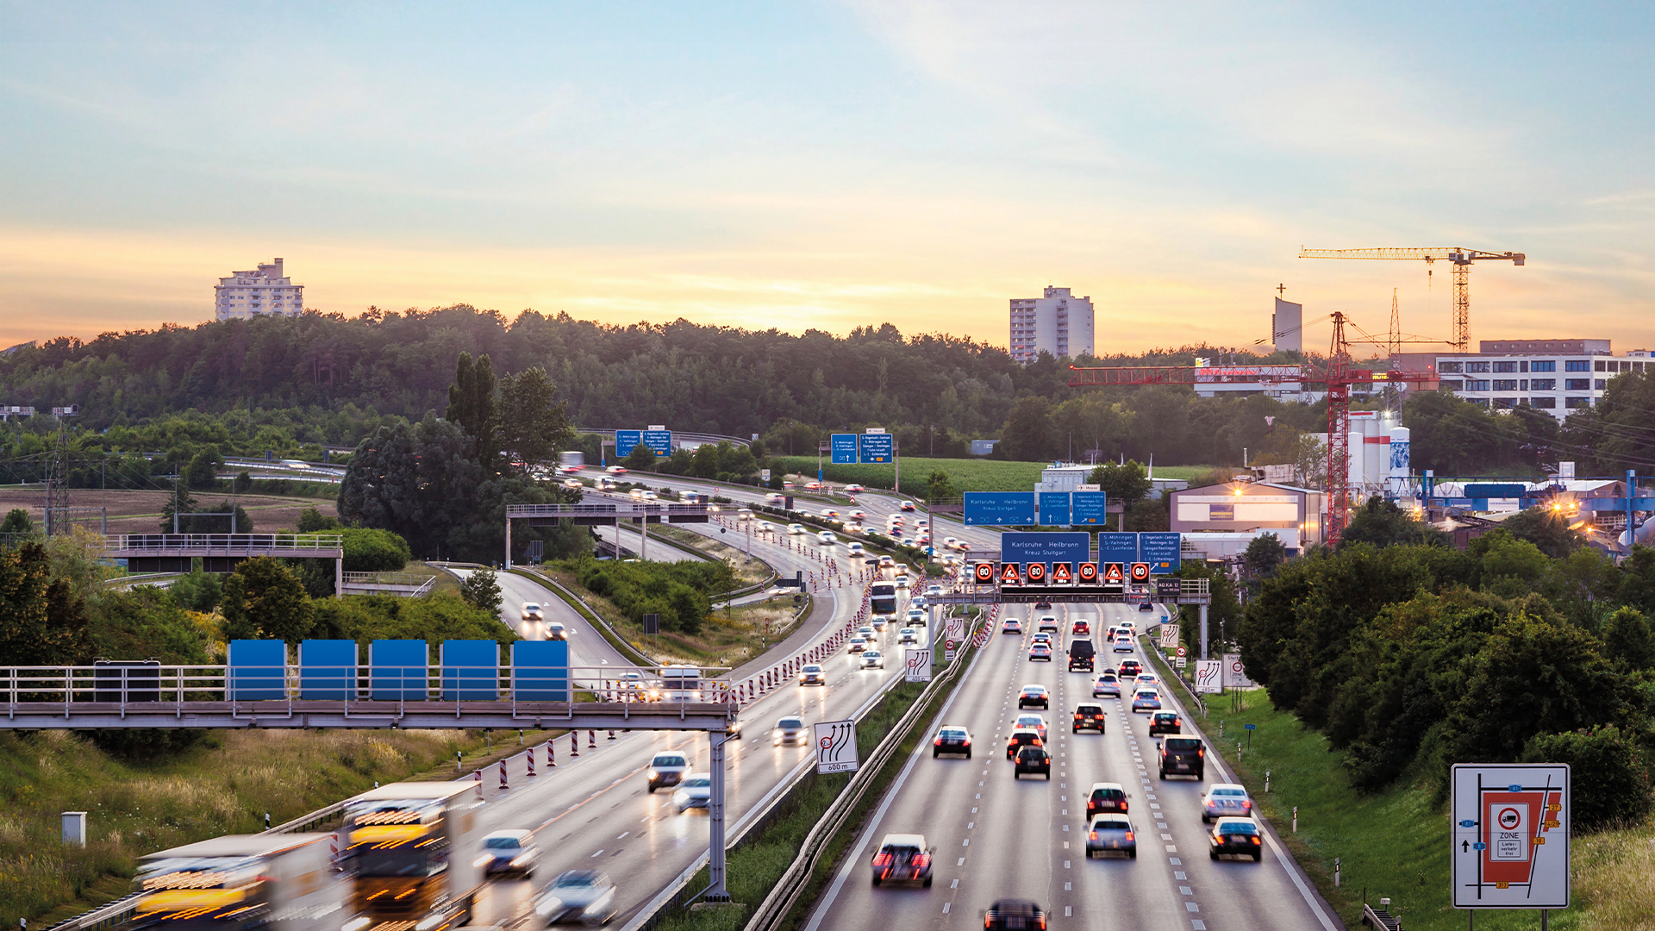

Driven by sustainable solutions for a future beyond fossils
PLYWOOD
AND SAWN TIMBER
for construction and
industrial applications
GRAPHIC AND
OFFICE PAPERS
for advertising and
home and office uses
ELECTRICITY
everywhere
PLYWOOD
for vehicle flooring
BIOCOMPOSITES
for various outdoor and
building material uses
PULP AND
SPECIALTY PAPERS
for packing materials
RENEWABLE BIOFUELS
for all diesel engines
LABEL MATERIALS
for information and
product labelling
| © UPM
| © UPM
| © UPM

Slide 15

UPM BioVerno – Driving cleaner traffic
Crude Tall Oil,
a residue of pulp making process
as raw material
No increase
in harvesting
nor land use
Outside food value chain
100%
80%
Renewable raw material
Less fossil CO₂ emissions
15
| © UPM
Notes:
BIOFUELS offer new growth opportunities beyond UPMs current product portfolio. The fuels markets are huge, supported by increasing demand for sustainable alternatives.
UPM Biofuels produces renewable and sustainable products for the transport and petrochemicals industries. UPM's innovative, bio-based products are frontrunners in quality, usability and sustainability and offer customers ways to replace fossil raw materials and reduce their carbon footprint.
UPM BioVerno is produced from tall oil, a residue of pulp making process, since early 2015. It is produced at UPM Lappeenranta Biorefinery, and in 2017, the refinery reached its design capacity and generated a good financial return.​ In February 2018, UPM announced that it is starting an environmental impact assessment (EIA) for a new possible biorefinery in Kotka, Finland. ​The EIA was completed in January 2019.
UPM is exploring opportunities to scale up the business by studying a potential larger biorefinery in Finland. An Environmental Impact Assessment (EIA) for a possible
biorefinery in Kotka, Finland has been made. The biorefinery would have a 500,000-tonne annual production of advanced biofuels made from sustainable raw materials for use in the road transport, marine and aviation sectors. The greenhouse gas emission savings delivered by this facility would be equivalent to removing 16% of the transport emissions generated in Finland. The potential new biorefinery would utilise several competitive and sustainable feedstocks, such as solid wood residues and other sustainable wastes and residues.
RSB certification
All our products are covered by Roundtable on Sustainable Biomaterials (RSB) EU RED certification. RSB certifies the sourcing chain for raw materials as well as the sustainability and reliability of manufacturing based on 12 principles approved by several stakeholders, such as NGOs and UN representatives.
These principles cover such aspects as greenhouse gas emissions, biodiversity, human rights, and social and environmental responsibility across the entire production chain. RSB EU RED is also one of the voluntary schemes approved by the European Commission for verifying that biofuels comply with European Union sustainability criteria.
ISCC certification
International Sustainability and Carbon Certification (ISCC EU) enables use of renewable fuels in transport in accordance with the European Union Directive on renewable energy. It also certifies the sustainability of our operations across the entire production chain.
UPM Biofuels have been granted an extensive ISCC PLUS sustainability certification covering all products from our biorefinery. ISCC PLUS is a sustainability certification system for bio-based materials, such as chemicals, foodstuffs and animal feeds. Our ISCC PLUS certification also includes whole lifecycle greenhouse gas emission calculations for all refinery streams in the same way as ISCC EU certification.

Slide 16
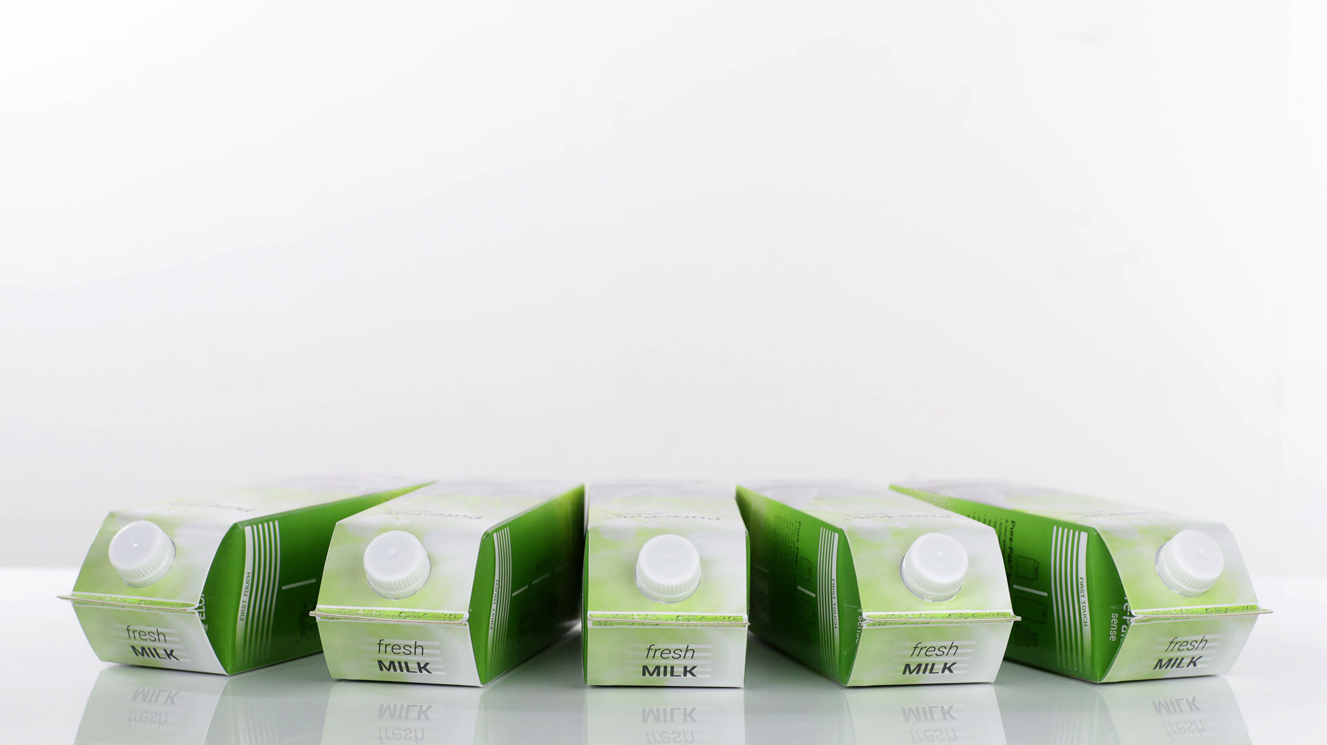

UPM BioVerno naphtha
– the natural solution for renewable plastic
Issue
Challenge
Solution
Biofore Beyond Fossils
20% of a typical carton is fossil-based plastic.
To develop a 100% renewable* beverage carton and reduce its CO₂ footprint.
Collaborating with Dow and Elopak to convert wood-based UPM BioVerno naphtha to plastic for cartons.
The 100%
wood-based beverage carton
*on mass balance basis
Notes:
UPM Biofuels, Dow and Elopak have joined forces to reduce the carbon footprint of packaging by utilizing our wood-based naphtha as raw material for plastic coating in liquid cartons.
Both the coating and the cap are 100% wood-based and recyclable plastic without compromising the technical properties.

Slide 17
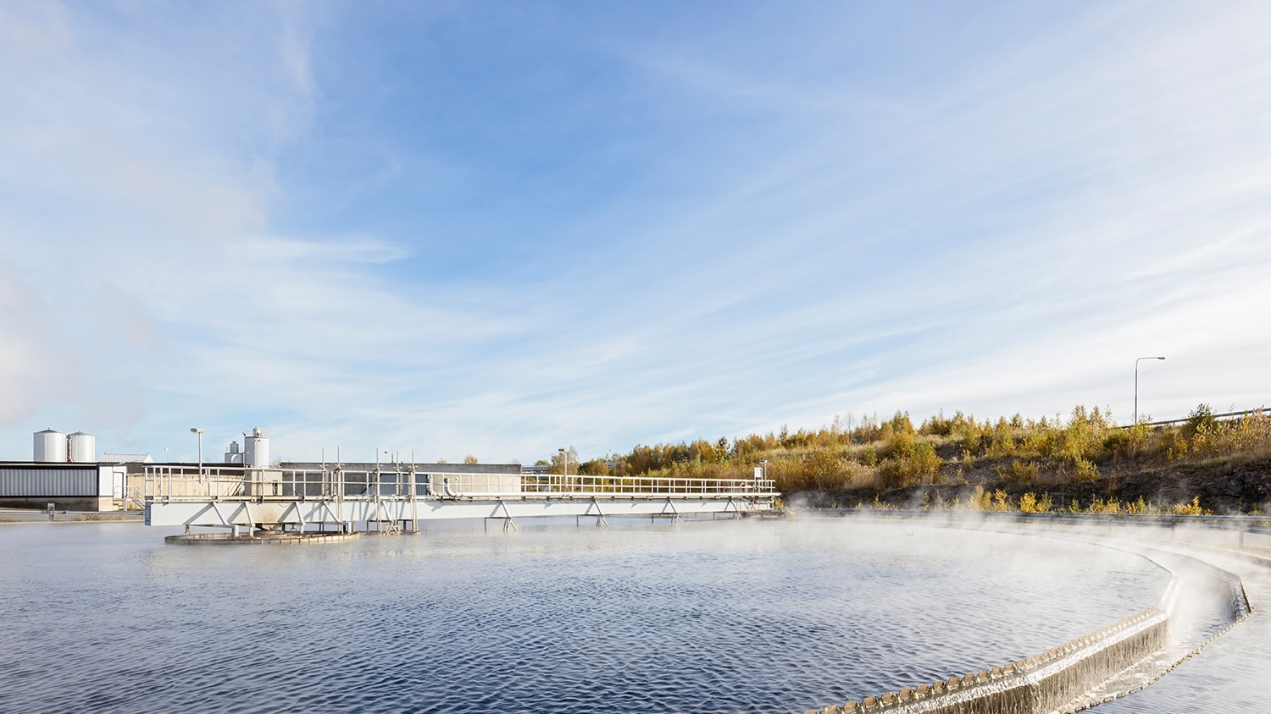

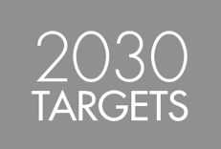

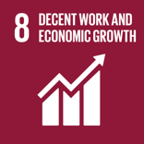
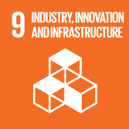
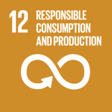
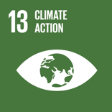
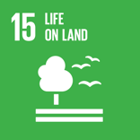

Our responsibility agenda is guided by the Biofore strategy and our targets are aligned with UN’s Sustainability
Development Goals (SDG’s)
Goals where our negative impact is largest and those where we can contribute
most positively
| © UPM
Notes:
We are actively promoting the Sustainable Development Goals (SDGs) of the 2030 Agenda for Sustainable Development published by the UN. In addition to participating in global projects, such as UN Global Compact LEAD, we also work with several local expert organisations to promote and achieve the SDGs.
We have identified the goals where our negative impact is largest and those where we can contribute most positively. Here are the six most important. Other SDGs are also relevant to us, but to a lesser extent or only indirectly.

Slide 18

Future beyond fossils is a key driver for us
| © UPM
Notes:
Our products to provide sustainable solutions that meet the challenges and opportunities presented by global megatrends. We are developing new innovative and high-quality products as well as renewable and recyclable materials from wood-based biomass. Wood fibre, biomolecules, residues and side streams are becoming increasingly important as the raw materials of the future.

Slide 19
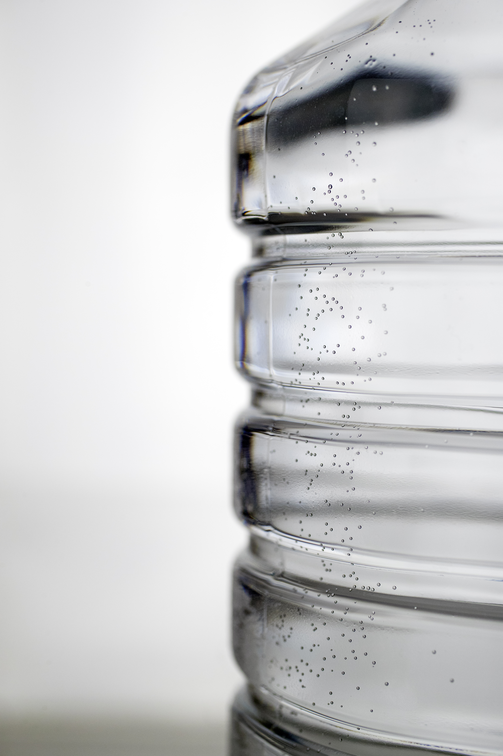
IS A KEY DRIVER TO US
Inspired by
the limitless opportunities of bioeconomy
Delivering renewable and responsible solutions
Innovating
for a future beyond fossils
Notes:
Future beyond fossils is a key driver for UPM going forward.
We are determined to be the Number One company offering a wide range of renewable and responsible solutions to the growing global demand.​
We are inspired by the limitless opportunities of bioeconomy that offers new opportunities for value creation and business growth for UPM. Thanks to our global capabilities, innovativeness and strong position in the forest biomass sourcing chain, we are in a unique position in all our businesses to advance a circular economy. At the same time, we see responsibility as a requirement for long-term value creation.
We deliver renewable and responsible solutions - our products are made of renewable raw materials and they’re recyclable. We continue to replace fossil materials in various use-cases. UPM’s sustainable and safe solutions are already changing businesses and lives around the world.
We are committed to innovate for a future beyond fossils and are as a bio-based forest industry increasingly replacing fossil materials and fuels. Our innovations create value and business opportunities for an era when the world is no longer dependent on fossils.

